Slide 1
JSP (JavaServer Pages)
JSP technology is used to create dynamic web applications.
JSP pages are easier to maintain then a Servlet.
JSP pages are opposite of Servlets as a servlet adds HTML code inside Java code, while JSP adds Java code inside HTML using JSP tags.
Everything a Servlet can do, a JSP page can also do it.
Successor of Servlet

Slide 2
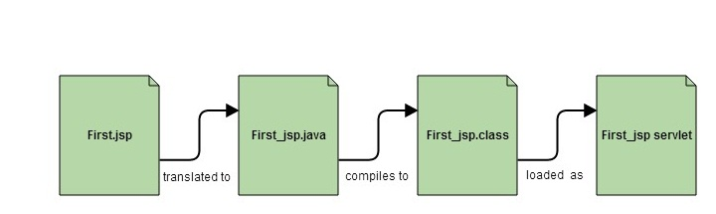
JSP enables us to write HTML pages containing tags, inside which we can include powerful Java programs.
In the end a JSP becomes a Servlet
JSP pages are converted into Servlet by the Web Container. The Container translates a JSP page into servlet class source(.java) file and then compiles into a Java Servlet class.

Slide 3
Why JSP is preferred over servlet? (Advantages)
JSP provides an easier way to code dynamic web pages.
JSP does not require additional file (web.xml).
JSP pages can be directly accessed, and web.xml mapping is not required like in servlets.
Easy to maintain and code.
High Performance and Scalability.
JSP is built on Java technology, so it is platform independent.

Slide 4
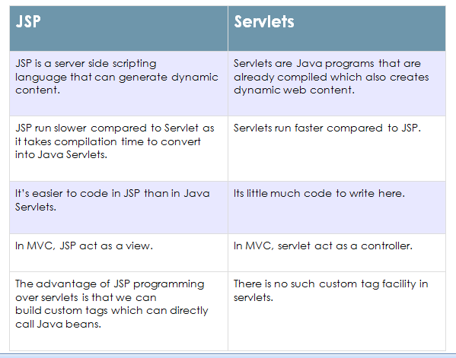

Slide 5
Lifecycle of JSP
The translation of a JSP page to a Servlet is called Lifecycle of JSP. JSP Lifecycle is exactly same as the Servlet Lifecycle, with one additional first step, which is, translation of JSP code to Servlet code.
Following are the JSP Lifecycle steps:
Translation of JSP to Servlet code.
Compilation of Servlet to bytecode.
Loading Servlet class.
Creating servlet instance.
Initialization by calling jspInit() method
Request Processing by calling _jspService() method
Destroying by calling jspDestroy() method

Slide 6
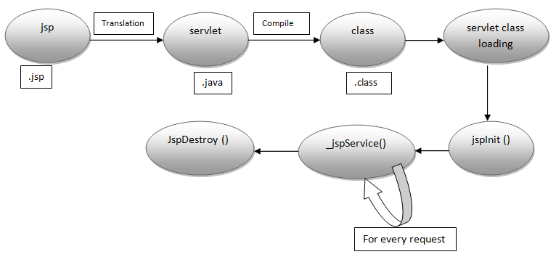

Slide 7
JSP Scripting Element
JSP Scripting element are written inside <% %> tags. The code inside <% %> tags are processed by the JSP engine during translation of the JSP page. Any other text in the JSP page is considered as HTML code or plain text.
There are five different types of scripting elements
Scripting Element Example
------------------------------------------------------------------------------------
Comment <%-- comment --%>
Directive <%@ directive %>
Declaration <%! declarations %>
Scriptlet <% scriplets %>
Expression <%= expression %>

Slide 8
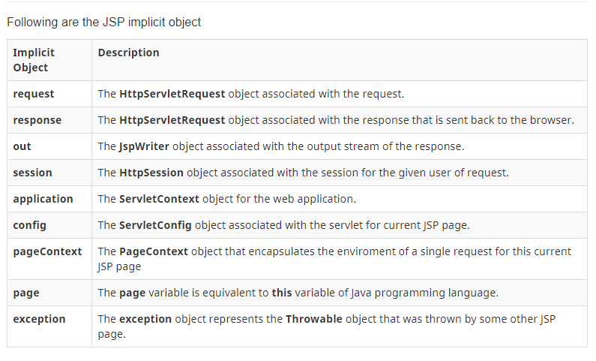
Implicit Objects in JSP (There are 9 JSP implicit objects. These objects are created by the web container that are available to all the JSP pages.)

Slide 9
JSP Directive Tag
Directive Tag gives special instruction to Web Container at the time of page translation.
Directive tags are of three types: page, include and taglib.
Directive Description
-------------------------------------------------------------------------------
<%@ page ... %> defines page dependent properties such as language, session, errorPage etc.
<%@ include ... %> defines file to be included.
<%@ taglib ... %> declares tag library used in the page

Slide 10
You can place page directive anywhere in the JSP file, but it is good practice to make it as the first statement of the JSP page.
The Page directive defines a number of page dependent properties which communicates with the Web Container at the time of translation. Basic syntax of using the page directive is <%@ page attribute="value" %> where attributes can be one of the following :
import attribute
language attribute
extends attribute
session attribute
isThreadSafe attribute
isErrorPage attribute
errorPage attribute
contentType attribute
autoFlush attribute
buffer attribute

Slide 11
import attribute : The import attribute defines the set of classes and packages that must be imported in servlet class definition. For example
<%@ page import="java.util.Date" %>
language attribute : language attribute defines language to be used in the page.
extends attribute : extends attribute defines the class name of the superclass of the servlet class that is generated from the JSP page.
session attribute : session attribute defines whether the JSP page is participating in an HTTP session. The value is either true or false.
isThreadSafe attribute : isThreadSafe attribute declares whether the JSP is thread-safe. The value is either true or false

Slide 12
isErrorPage attribute : isErrorPage attribute declares whether the current JSP Page represents another JSP's error page.
errorPage attribute : errorPage attribute indicates another JSP page that will handle all the run time exceptions thrown by current JSP page. It specifies the URL path of another page to which a request is to be dispatched to handle run time exceptions thrown by current JSP page.
contentType attribute : contentType attribute defines the MIME( Multipurpose Internet Mail Extensions) type for the JSP response.
autoFlush attribute : autoFlush attribute defines whether the buffered output is flushed automatically. The default value is "true".
buffer attribute : buffer attribute defines how buffering is handled by the implicit out object.

Slide 13
JSP Standard Tag(Action Element)
JSP specification provides Standard(Action) tags for use within your JSP pages.
These tags are used to remove or eliminate scriptlet code from your JSP page because scriptlet code are technically not recommended nowadays. It's considered to be bad practice to put java code directly inside your JSP page.
Standard tags begin with the jsp: prefix. There are many JSP Standard Action tag which are used to perform some specific task.

Slide 14
The following are some JSP Standard Action Tags available:
Action Tag Description
----------------------------------------------------------------------------------
jsp:forward forward the request to a new page <jsp:forward page="Relative URL" />
jsp:include includes the runtime response of a JSP page into the current page.
jsp:param Adds parameters to the request object.
jsp:useBean instantiates a JavaBean
<jsp:useBean id="beanId" />

Slide 15
5) jsp:getProperty : retrieves data from the property of any JavaBean instance.
<jsp:useBean id="beanId" class=“beanName” />
...
<jsp:getProperty name="beanId" property="someProperty" .../>
Where, beanName is the name of pre-defined bean whose property we want to access.
6) jsp:setProperty :store data in property of any JavaBeans instance
<jsp:useBean id="beanId" class=“beanName” />
...
<jsp:setProperty name="beanId" property="someProperty" value="some value"/>
Where, beanName is the name of pre-defined bean in which we set the value to the property.

Slide 16
jsp:useBean action tag
<jsp:useBean id= "instanceName" scope= "page | request | session | application" class= "packageName.className"> </jsp:useBean>
Attributes and Usage of jsp:useBean action tag :
id: is used to identify the bean in the specified scope.
class: instantiates the specified bean class (i.e. creates an object of the bean class) but it must have no-arg or no constructor and must not be abstract.

Slide 17
scope: represents the scope of the bean. It may be page, request, session or application. The default scope is page.
page: specifies that you can use this bean within the JSP page. The default scope is page.
request: specifies that you can use this bean from any JSP page that processes the same request. It has wider scope than page.
session: specifies that you can use this bean from any JSP page in the same session whether processes the same request or not. It has wider scope than request.
application: specifies that you can use this bean from any JSP page in the same application. It has wider scope than session.

Slide 18
What is AJAX ?
AJAX = Asynchronous JavaScript And XML.
Ajax is not a programming language, it is a concept.
AJAX just uses a combination of:
A browser built-in XMLHttpRequest API (to request data from a web server)
JavaScript and HTML DOM (to display or use the data)
AJAX allows web pages to be updated asynchronously by exchanging data with a web server behind the scenes. This means that it is possible to update parts of a web page, without reloading the whole page.

Slide 19
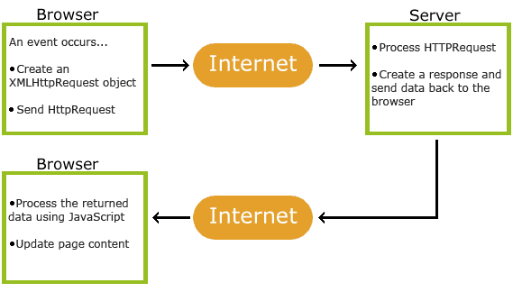
How AJAX Works ?

Slide 20
Steps
1. An event occurs in a web page (the page is loaded, a button is clicked)
2. An XMLHttpRequest object is created by JavaScript
3. The XMLHttpRequest object sends a request to a web server
4. The server processes the request
5. The server sends a response back to the web page
6. The response is read by JavaScript
7. Proper action (like page update) is performed by JavaScript

Slide 21
Create an XMLHttpRequest Object
All modern browsers (Chrome, Firefox, IE7+, Edge, Safari, Opera) have a built-in XMLHttpRequest object.
Syntax for creating an XMLHttpRequest object:
variable = new XMLHttpRequest();
Example
var xhttp = new XMLHttpRequest();

Slide 22
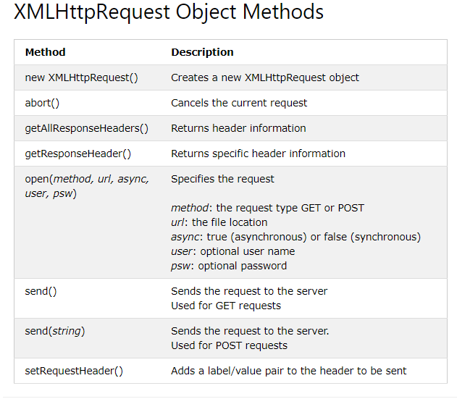

Slide 23
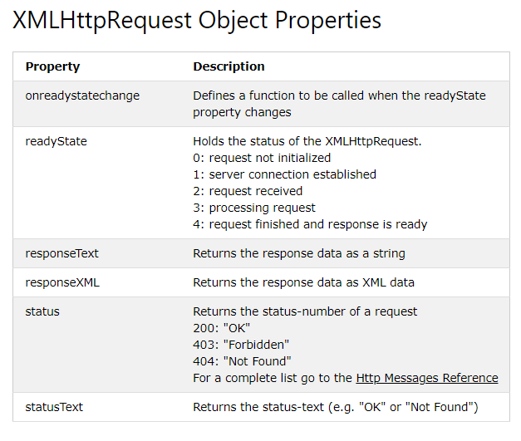

Slide 24
Note
Synchronous XMLHttpRequest (async = false) is not recommended because the JavaScript will stop executing until the server response is ready. If the server is busy or slow, the application will hang or stop.

Slide 25
Send a Request To a Server
To send a request to a server, we use the open() and send() methods of the XMLHttpRequest object:
xhttp.open("GET", "ajax_info.txt", true);
xhttp.send();

Slide 26
The onreadystatechange Property
The onreadystatechange property defines a function to be executed when the readyState changes.
The readyState property holds the status of the XMLHttpRequest.
The status property and the statusText property holds the status of the XMLHttpRequest object.
The onreadystatechange function is called every time the readyState changes.
When readyState is 4 and status is 200, the response is ready.
The onreadystatechange event is triggered four times (1-4), one time for each change in the readyState.

Slide 27
Example
function loadDoc() { var xhttp = new XMLHttpRequest(); xhttp.open("GET", "ajax_info.txt", true); xhttp.send(); xhttp.onreadystatechange = function() { if (this.readyState == 4 && this.status == 200) { document.getElementById("demo").innerHTML = this.responseText; } }; }

